Slide 1


TECHNOLOGICAL INDUSTRIAL DEVELOPMENT ZONE
TIDZ Tetovo

Slide 2
ABOUT US
NORMAK INVESTMENT GROUP AD TETOVO
Established in January 2013 as a Joint Stock Company - 100% owned by Normak Investment Group AS from Norway.
April 5, 2013 signed a Public Private Partnership Agreement with the Government of North Macedonia as the founder of the Technological Industrial Development Zones (TIDZ), for development, financing, management and management of the work as the founder of the Technological Industrial Development Zone in Tetovo.
Previous investment in Tetovo TIDZ - over 40 million euros.
Next step: Tetovo TIDZ - first green Technological industrial development zone in the country and the region that will fully provide green energy to existing and future investors in the zone.

Slide 3
Why Macedonia
Why Macedonia
Advantage from the strategic geographical position, being at the crossroads of 2 main European transport corridors (8 and 10);
Highly liberalized foreign trade policy and has signed various bilateral agreements that allow local producers free access to the European Union and other markets, making North Macedonia competitive for growth in production and exports.;
Stable monetary environment with one of the lowest inflation rates in the region and a stable currency;
Favourable tax package with one of the lowest profit tax rates in the world;
Highly skilled labor force and one of the most competitive countries in SEE in terms of labor costs in Europe;
Government openness to investors
NATO member and EU candidate country.
Quick company registration - One-stop system that allows investors to register their businesses after 4 hours of submitting on application

Slide 4
Free Trade Agreements
Free Trade Agreements
Macedonia is a signatory of three multilateral Free Trade Agreements:
  SAA (Stabilization and Association Agreement) with the EU member states
  EFTA (Switzerland, Norway, Iceland and Liechtenstein)
  CEFTA (Macedonia, Albania, Moldova, Serbia, Montenegro, Bosnia and Herzegovina, and Kosovo)
Bilateral Free Trade Agreements are signed with Turkey and Ukraine.

Slide 5
Investment Protection Treaties
Investment Protection Treaties
The Republic of Macedonia has signed investment protection treaties with the following countries:
  Albania, Serbia, Bulgaria, Turkey, Croatia, Bosnia and Herzegovina, Slovenia, Romania, Austria, Germany, Switzerland, Netherlands, Belgium, France, Italy, Spain, Hungary, Czech Republic, Poland, Ukraine, Sweden, Finland, Russian Federation, People’s Republic of China, Malaysia, Republic of Korea, and India.
In the process of ratification are Agreements with:
  Arab Republic of Egypt, Iran, and Belarus. Negotiations with the following countries are complete, and the Agreements are to be signed as soon as possible: Greece, Great Britain, Uzbekistan, Denmark, Oman, Slovak Republic, and Kuwait.

Slide 6
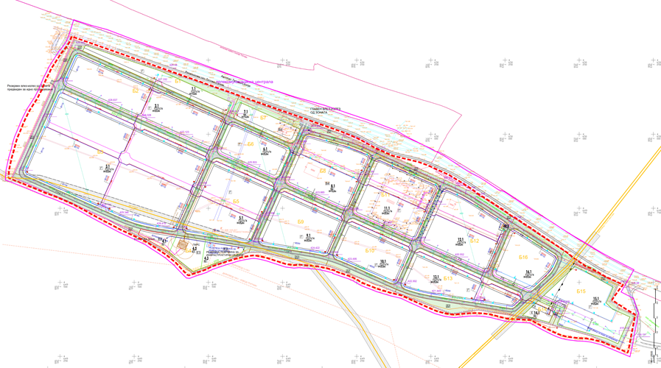
TIDZ Tetovo
Total area - 95 hectares
Size of plots - according to the needs of investors

Slide 7
Taxes, Customs and other Incentives
Investment benefits
10 YEARS TAX HOLIDAY
Investors in TIDZ are entitled to a 10-years tax holiday from income tax and corporate tax and a 100% reduction in personal income tax for up to 10 years. Investors are exempt from paying value added tax on imports and trade of goods in free zones. Additionally, investors are exempt from paying customs duties on equipment, machinery and spare parts.
LONG-TERM LEASE
The land in the free zones is available under long-term lease for a period of up to 99 years at concessionary prices.
EXEMPTED FROM PAYMENT OF FEE
Investors are exempt from paying utility fees.

Slide 8
Taxes, Customs and other Incentives
Investment benefits
FREE CONNECTION
Free connection to water and sewerage network.
50% RETURN ON INVESTMENT COSTS
The Government of North Macedonia can support the growth of capital investments and income by returning 50% of the investment costs in new machinery and equipment, or investments in facilities and land.
ADDITIONAL UNIQUE BENEFITS FROM NORMAK INVESTMENT GROUP
Providing all the necessary documentation and construction of your Factory - Production plant at the expense of Normak Investment Group according to the needs and specifications of investors

Slide 9
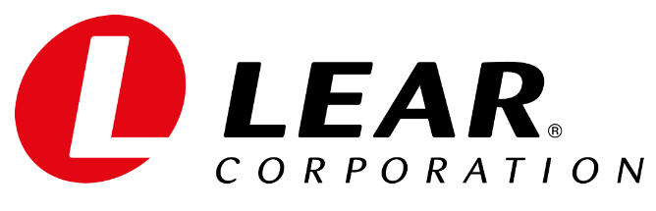

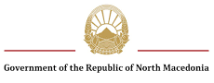

TIDZ Tetovo
Investors
Partners

Slide 10
Address: Skopski Pat 1, TIDZ Tetovo,
1200 Tetovo, R. N. Macedonia
E-mail: info@normakinvest.com
Web: www.normakinvest.com

